Slide 1
Smelting reduction of iron oxides from bauxite residue in view of improved rare earths leaching
C. R. Borra, B. Blanpain, Y. Pontikes,
K. Binnemans, T. Van Gerven
Notes:
Good Morning all. My self Chenna Rao, Predoc in chemical engineering Dept. I am working on recovery of rare earth elements from Red mud, the waste generated in Aluminum production.

Slide 2
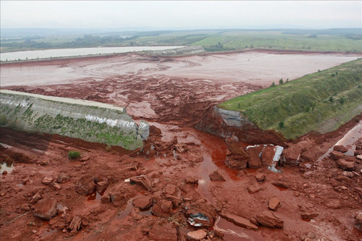
Introduction
Bauxite residue is a waste generated in Bayer’s Process (1.5-2.5 ton/ton alumina)
Occupies land, harmful for environment
Minor use in cements and ceramics
Needs better management strategies
Rare earth elements (REEs) – report to bauxite residue
95% of the value is from Sc
Binnemans et al., J. Clean. Prod. (2015), in press, DOI: 10.1016/j.jclepro.2015.02.089
1

Slide 3
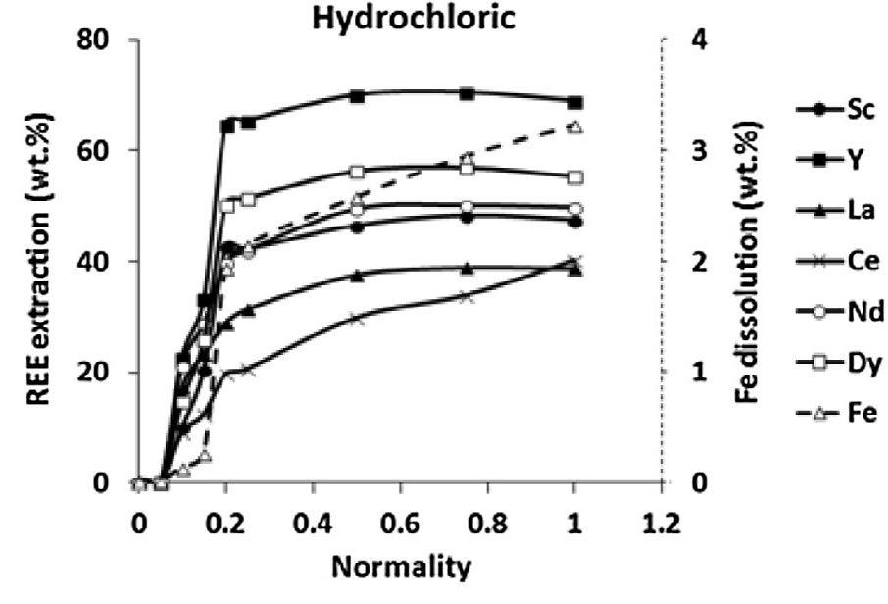
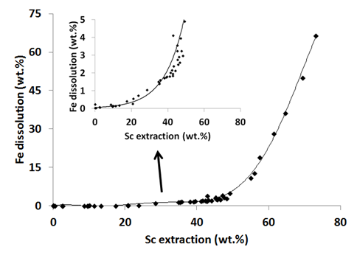
Introduction
Direct acid leaching of REEs yields low recovery rates
High HCl acid concentration increases the recovery but then high amounts of iron also dissolve
High iron concentration in the solution requires large amount of reagents during recovery
Goal: remove iron prior to REE leaching
(T: 25 °C, L/S: 50, t: 24 h)
Borra et al., Miner .Eng. (2015), in press, DOI: 10.1016/j.mineng.2015.01.005
2

Slide 4
Characterisation of bauxite residue
Greek
bauxite residue
Borra et al., Miner .Eng. (2015), in press, DOI: 10.1016/j.mineng.2015.01.005
3

Slide 5
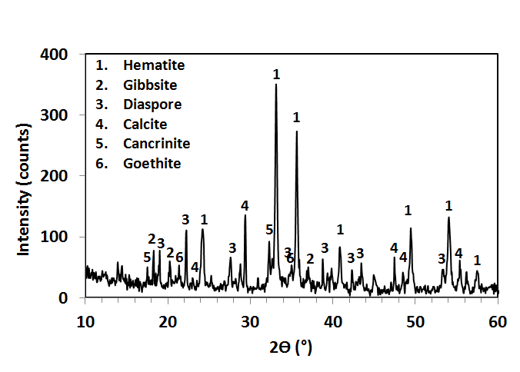
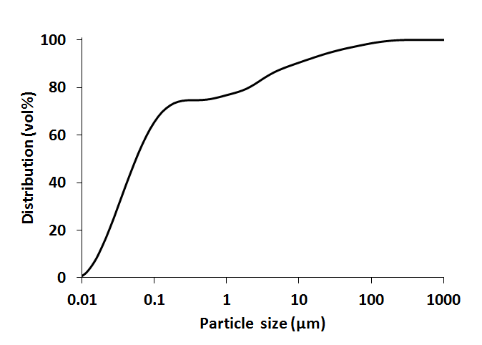
Characterisation of bauxite residue
Greek
bauxite residue
Borra et al., Miner .Eng. (2015), in press, DOI: 10.1016/j.mineng.2015.01.005
4

Slide 6
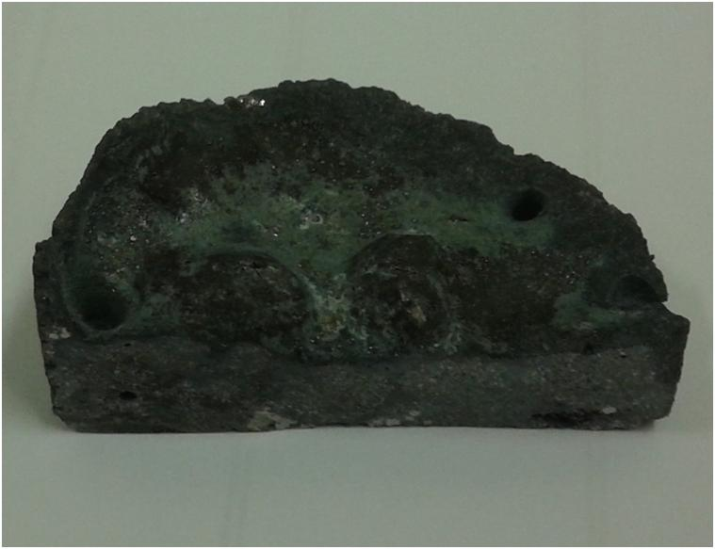
Smelting for iron removal – 1st attempt
Carbon requirement: Fe₂O₃ + 3C  2Fe + 3CO
Smelting was carried out with 10 wt% carbon and no flux at 1500-1600 °C
Result:
No or very little
slag-metal separation
without flux
Without flux and 10 wt% carbon at 1600 °C
5

Slide 7
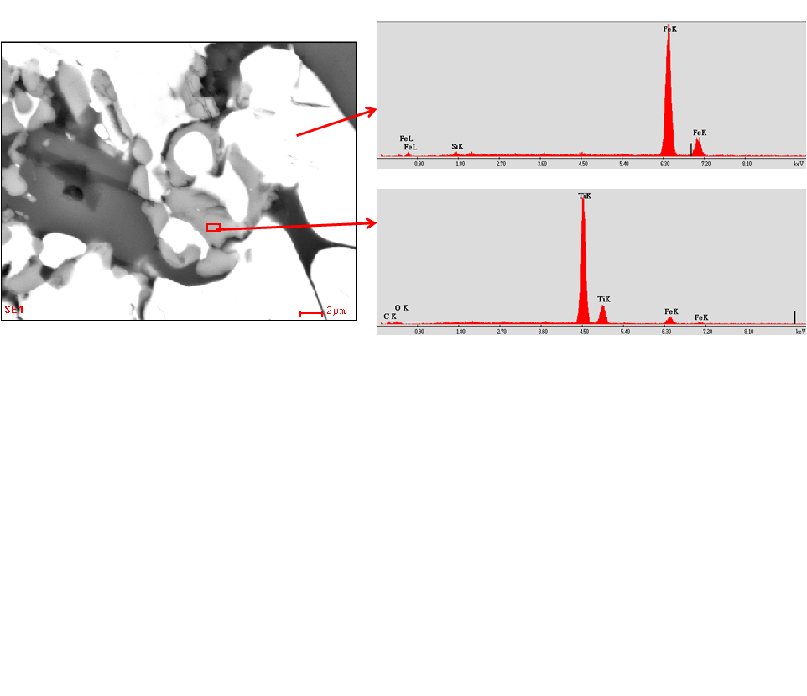
Smelting for iron removal – 1st attempt
Further observations:
Si was found in the metal phase. TiO₂ was also reduced
Carbon was too high due to the formation of CO₂
Fe
Si
Ti
Without flux and 10 wt% carbon at 1600 °C
6

Slide 8
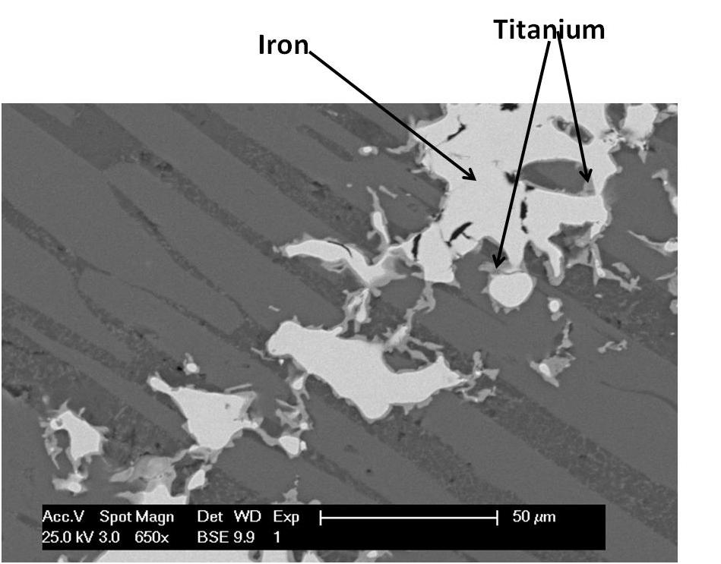
Smelting for iron removal – 2nd attempt
Carbon was decreased from 10 to 7 wt% to decrease the reduction of SiO₂
Wollastonite (CaSiO₃) was added to decrease the fluidity
Result:
Metallic titanium was observed even at 7 wt% C and 20 wt% CaSiO₃
Titanium hinders the slag-metal separation by locking iron phase
20 wt% CaO-SiO₂ and 7 wt% carbon at 1500 °C
7

Slide 9
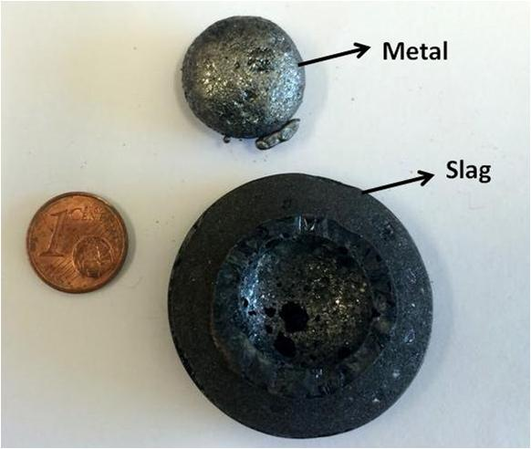
Smelting for iron removal – 3rd attempt
Carbon was further decreased to 5 wt%
Iron was successfully separated at 1500 °C with 5 wt% C and 20 wt% CaSiO₃
Wollastonite below 20% decreases the slag-metal separation
Iron recovery → 96%
Result:
20 wt% CaSiO₃ and 5 wt% carbon at 1500 °C
8

Slide 10
Slag composition
Bauxite residue
Bauxite residue
Slag
X 1.4
- 95%
Slag
9

Slide 11
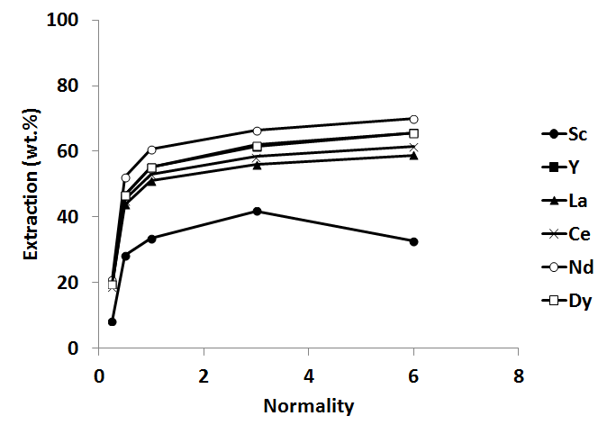
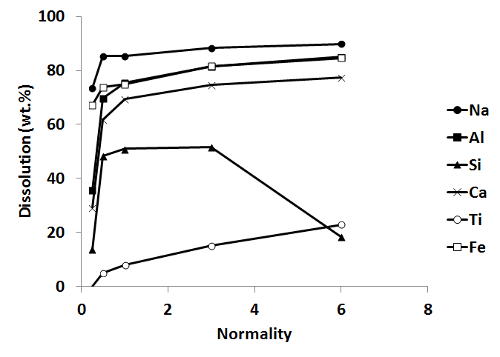
Slag leaching at room temperature
(HCl, T: 25 °C, t: 24 h, L/S: 50)
Room temperature leaching yields low REE recoveries
Ti dissolution is too low as well
10

Slide 12
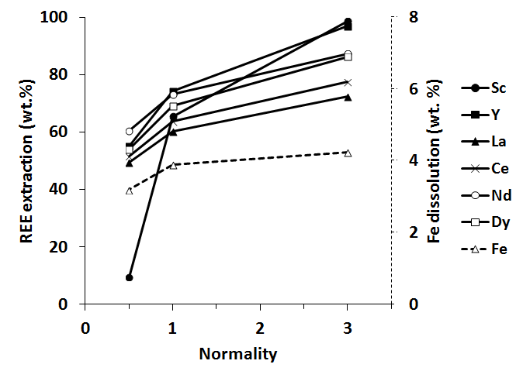
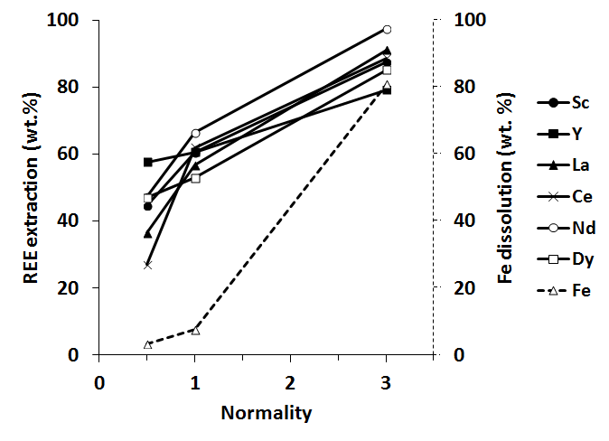
Slag leaching at increased temperature
Slag
Bauxite residue
(HCl, T: 90 °C, t: 1 h, L/S: 50)
Complete Sc extraction from slag. Ti recovery is more than 70%
Fe dissolution is very high from bauxite residue at similar conditions
11

Slide 13
Conclusions
Carbon content above 5% and CaSiO₃ below 20% decreases slag-metal separation
More than 95% of Fe can be recovered by smelting
Subsequent room-temperature leaching gives low recoveries
All of the Sc, most of other REEs and about 70% of Ti can be leached with high-temperature leaching after smelting
Succesful extraction of REE with minimal dissolution of Fe
12

Slide 14
Acknowledgements
Aluminum of Greece for providing the bauxite residue sample
DBOF grant from KU Leuven to CRB
FWO post-doctoral fellowship to YP
Research Platform for the Advanced Recycling and Reuse of Rare Earths (IOF-KP RARE³)
www.set.kuleuven.be/mrc/sim2 www.kuleuven.rare3.eu
13

Slide 15

See you at ….?
14

