Slide 1
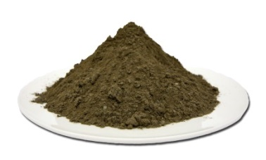
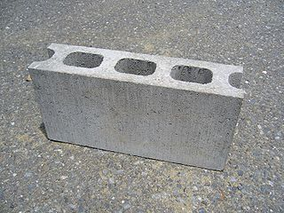
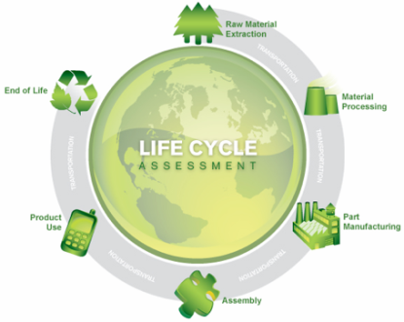
Producing bricks from stainless steel slags: an environmental evaluation based on Life Cycle Analysis
Andrea DI MARIA; Muhammad SALMAN; Karel VAN ACKER. Maarten DUBOIS
Notes:
versie 15/01/2014

Slide 2
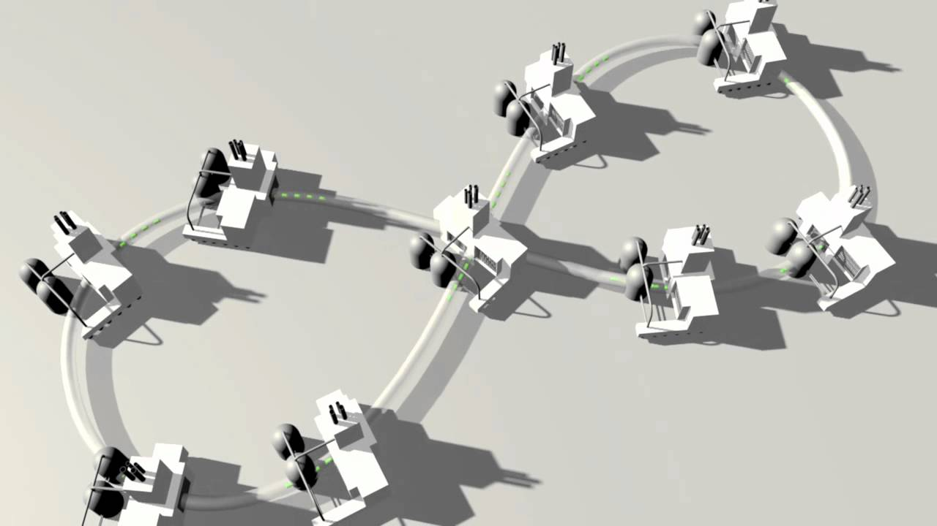
Industrial symbiosis in the steel sector
Industrial symbiosis
“In nature, there is no such thing as waste…”
IS is a system innovation aiming to share services, resources and by-products among different industries
Industrial symbiosis in the steel sector
Flue gas and steam to nearby industries
Blast Furnace Slag (BFS) in cement production
…There is still a need for research focused on the valorisation of other residues whose potential is not explored at present:

Slide 3
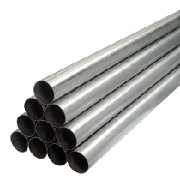
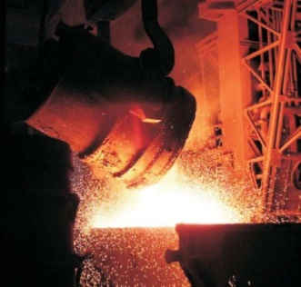
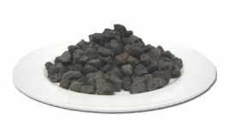
The Stainless Steel Slag (SSS)
Stainless steel production by-products
300 Kg of SSS each tonne of steel produced
8,7 Mtons of SSS produced in 2011
Several types of slags generated:
Electric Arc Furnace (EAF)→melting
Argon Oxygen Decarburation (AOD) →refining
Continuous Casting (CtCs) →final stage
Industrial
Product
Stainless Steel
Industrial
By-product
SS Slag

Slide 4
The Stainless Steel Slag (SSS)
Average chemical composition (AOD slag)
Oxides | CaO | SiO₂ | MgO | Al₂O₃ | TiO₂ | Cr₂O₃ | Fe₂O₃ | Others
wt% | 57 | 29 | 8 | 2 | 1 | 0,6 | 0,6 | 1,8
Threats
Hazardous compounds (Cr, Pb, Ni, Cd ). Borates or cement addition to stabilised the slag
Fine particles (mm÷μm)
Strengths and Opportunities
SSS contains high quality oxides (CaO,SiO₂,Al₂O₃,MgO)

Slide 5
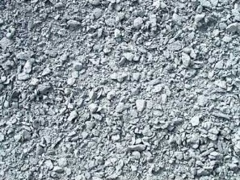
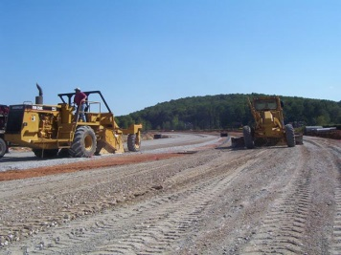
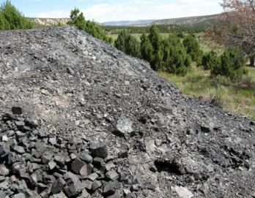
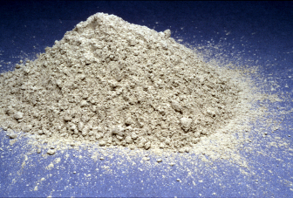
The Stainless Steel Slag (SSS)
Possible end-of-life destinations of SSS
Reclamation of waste steel and iron
Utilization in road construction (aggregates substitution)
Stabilization required!
Landfilling
New development
Production of binder for construction material

Slide 6
The StainlessSteelSlag (SSS) blocks: General
The Alternative…
Use of SSS as binder for the production of new construction material
The project SMARTPRO²
Production of new construction material in the form of masonry blocks (SSS blocks) from fine AOD slag:
AOD slag composition: closer to binder than to aggregates
Fine particles: Avoid energy intensive milling
4 different blocks, 2 different processes applied:
Alkali activation
Carbonation

Slide 7
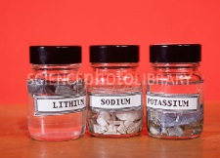
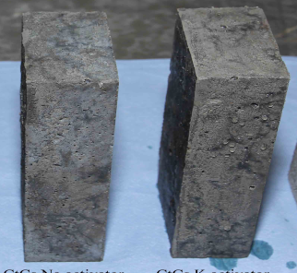
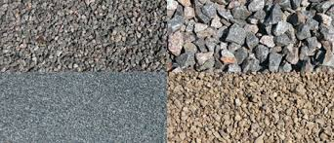
The StainlessSteelSlag (SSS) blocks: General
Alkali Activation
Chemical process that transforms glassy structures into compact and well cemented composites, through chemical activation with alkali compounds
Alkali activators
(sodium silicates)
AOD Stainless
Steel
Slag
Solid
block
Aggregates
Viable alternative to Ordinary Portland Cement (OPC)
Potential to reach high mechanical strength
7

Slide 8
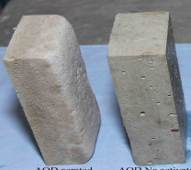
The StainlessSteelSlag (SSS) blocks: General
Alkali Activation: The block production process
+ Alkali activators
+ Aggregates
Solid
AA block
(Alkali activation)
AOD Stainless
Steel
Slag
+ Alkali activators
+ Aggregates
+ Aluminum
Aerated
AA block
8

Slide 9
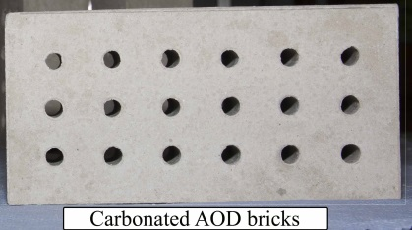
The StainlessSteelSlag (SSS) blocks: General
Carbonation
Method of carbon capture that accelerates the natural weathering of calcium, magnesium and silicon oxides, allowing them to react with CO₂ to form stable carbonate
$$Ca{(OH)}_{2}+{CO}_{2}=Ca{CO}_{3}+H_{2}O$$
Solid
block
Oxides
Carbonates (Solid)
Developed mainly as a technique to capture CO₂ (carbon sink)
Arising interest for industrial by-products
Industrial ecology concept
CO₂ uptaking + Waste reduction + High value end product
9

Slide 10
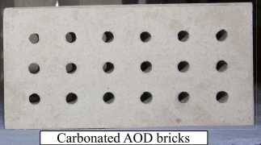
The StainlessSteelSlag (SSS) blocks: General
Carbonation: The block production process
Reactor
2,5 hours
8 bars
80 °C
Energy required!
Solid
CR block
(Carbonation)
AOD Stainless
Steel
Slag
Solid
CC block
Chamber
7 days
1,01 bars
22 °C
10

Slide 11
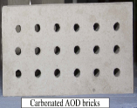
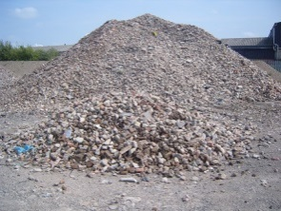
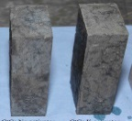
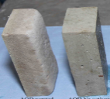
The StainlessSteelSlag (SSS) blocks: General
Research question
Is the valorization of AOD slag as SSS blocks beneficial in terms of impacts for the environment?
Solid
CR block
reactor
Carbonation
Solid
CC block
chamber
Solid
AA block
AOD Stainless
Steel
Slag
Alkali activation
Aerated
AA block
Production Phase
Disposal Phase
11

Slide 12
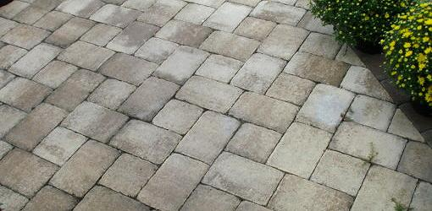
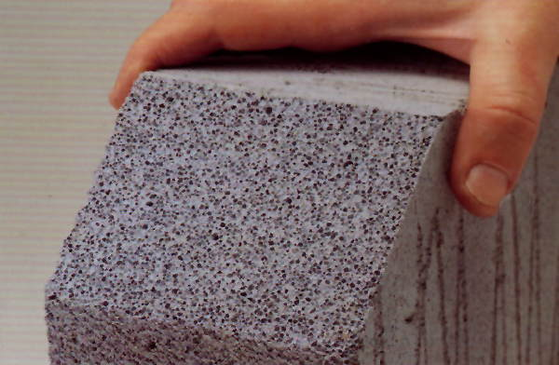
The StainlessSteelSlag (SSS) blocks: LCA
Comparison of three different scenarios:
SSS valorization through the production of SSS blocks
NO valorization (boric oxide stabilization and use as aggregates)
Production of the alternative to SSS block already available in the market
Solid
AA block
Solid
CR block
Concrete
Paver
block
Solid
CC block
Autoclaved
concrete
block
Aerated
AA block
12

Slide 13
The StainlessSteelSlag (SSS) blocks: LCA
Goal
and
Scope
Functional unit
System boundaries
Inventory
Analysis
The LCA framework
Data collection
Data treatment
Impact
Assessment
Calculation method
Results analysis
13

Slide 14
The StainlessSteelSlag (SSS) blocks: LCA
Goal
and
Scope
Functional unit
System boundaries
Inventory
Analysis
The LCA framework
Impact
Assessment
14

Slide 15
The StainlessSteelSlag (SSS) blocks: LCA
Scope
To assess the environmental impacts of new developed construction blocks made through the activation of AOD slag, in order to evaluate the environmental benefits arising from the application of industrial ecology concepts to steel sector.
Functional unit
Impacts related to the life cycle of 1m² blocks
Volume of 1 block: 25x5x10 cm (1000cm³)
In 1 m² → 50 blocks
Different weight for 1 m² (different density)
Comparison 1
AA solid= 111 kg/m² ; CC solid= 107 kg/m²; CR solid= 107 kg/m²; Paver= 134 kg/m²
Comparison 2
AA aerated= 58 kg/m² ; Autoclaved= 25 kg/m²
15

Slide 16
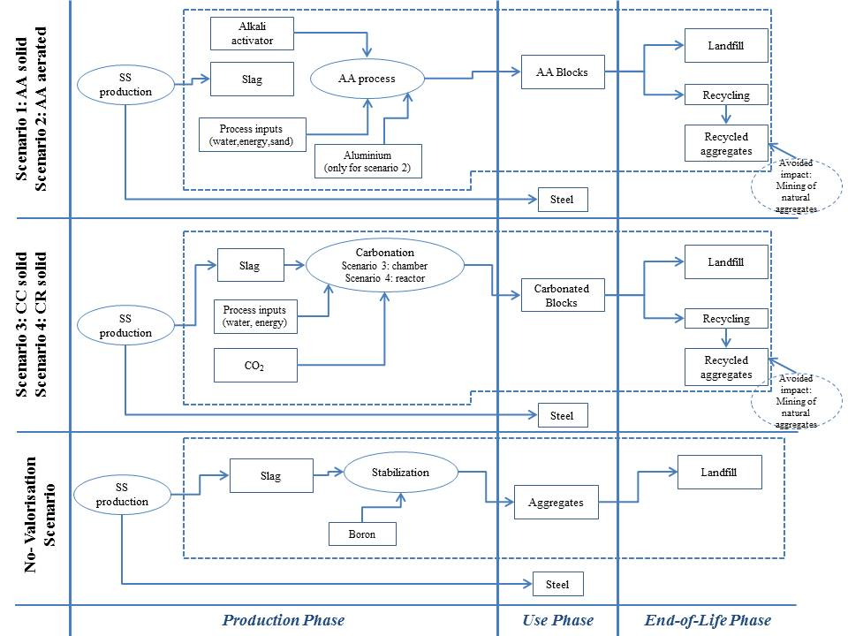
The StainlessSteelSlag (SSS) blocks: LCA
System Analysis
Alkali activation
Carbonation
16

Slide 17
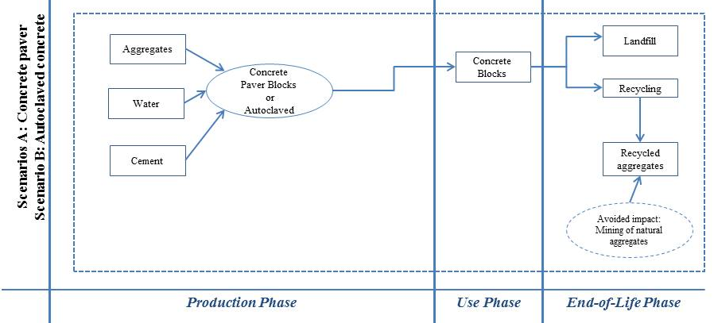
The StainlessSteelSlag (SSS) blocks: LCA
Traditional blocks
17

Slide 18
The StainlessSteelSlag (SSS) blocks: LCA
The StainlessSteelSlag (SSS) blocks: LCA
Goal
and
Scope
Inventory
Analysis
The LCA framework
Data collection
Data treatment
Impact
Assessment
18

Slide 19
The StainlessSteelSlag (SSS) blocks: LCA
Inventory table
 | Scenario 1 AA Solid blocks (Alkali Activated) 1 block= 2,2 kg |  | Scenario 2 AA Aerated blocks (Alkali Activated) 1 block= 1,1 kg | Scenario 3 C-R solid blocks (carbonated react) 1 block= 2,1 kg | Scenario 4 C-C solid blocks (carbonated chamb) 1 block = 2,1 kg | Scenario A Concrete paver blocks 1 block = 2,1 kg | Scenario B Autoclaved concrete blocks 1 block = 0,6 kg
Density (g/cm³) | 2,22 |  | 1,16 | 2,14 | 2,14 | 2,6 | 0,6
Weight of FU (kg) | 111 |  | 58 | 107 | 107 | 134 | 25
INPUT
Quantity of slag (kg) |  | 39 | 18 | 101 | 101 | / | /
NaOH (kg) |  | 1,4 | 2,8 | / | / | / | /
Na silicate (kg) |  | 3 | 3,4 | / | / | / | /
River Sand (kg) |  | 60 | 28 | / | / | 108 | 11
Aluminum powder (kg) |  | / | 0,009 | / | / | / | 0,01
Energy (kWh) |  | 0,04 | 0,04 | 62 | / | / | 10
Boric oxide to stabilize |  | 0,7 | 0,3 | 2,1 | 2,1 | / | /
Water (kg) |  | / | / | 19 | 19 | 7 | 10
CO_{2_input} (kg) |  | / | / | 17 | 17 | / | /
Portland Cement (kg) |  | / | / | / | / | 20 | 4
Limestone (kg) |  | / | / | / | / | / | 3
19

Slide 20
The StainlessSteelSlag (SSS) blocks: LCA
Goal
and
Scope
Inventory
Analysis
The LCA framework
Impact
Assessment
Calculation method
Results analysis
20

Slide 21
The StainlessSteelSlag (SSS) blocks: LCA
Calculation methodology
ReCiPe
Substances
Impact category | Total | Unit
Climate change | 4,041874 | kg CO2 eq
Ozone depletion | 2,96E-07 | kg CFC-11 eq
Terrestrial acidification | 0,017053 | kg SO2 eq
Freshwater eutrophication | 0,003442 | kg P eq
Marine eutrophication | 0,001289 | kg N eq
Human toxicity | 3,274149 | kg 1,4-DB eq
Photochemical oxidant formation | 0,010805 | kg NMVOC
Particulate matter formation | 0,005966 | kg PM10 eq
Terrestrial ecotoxicity | 0,000379 | kg 1,4-DB eq
Freshwater ecotoxicity | 0,019231 | kg 1,4-DB eq
Marine ecotoxicity | 0,022642 | kg 1,4-DB eq
Ionising radiation | 2,547385 | kBq U235 eq
Agricultural land occupation | 0,122318 | m2a
Urban land occupation | 0,052585 | m2a
Natural land transformation | 0,00107 | m2
Water depletion | 26,3019 | m3
Metal depletion | 0,171878 | kg Fe eq
Fossil depletion | 1,149028 | kg oil eq
Midpoints
Endpoints
Ozone depletion
Human toxicity
Human Health
(Daly)
Radiation
Damage
Ozoneformation
Raw Materials
Land use
CO₂
VOC
P
SO₂
NO_{x}
CFC
PAH
DDT
Particules form.
Climate change
Terr. ecotox
Single
Score
Terr. acidif.
Agr. land occ.
Urban. land occ.
Ecosystems
(Species yr.)
Nat. land transf
Damage
Marine ecotox.
Marine eutr.
Freshwater eutr.
Freshw. Ecotox.
Fossil fuel cons
Resources
(Cost)
Mineral cons.
Damage
Uncertainty
Water cons.
21

Slide 22
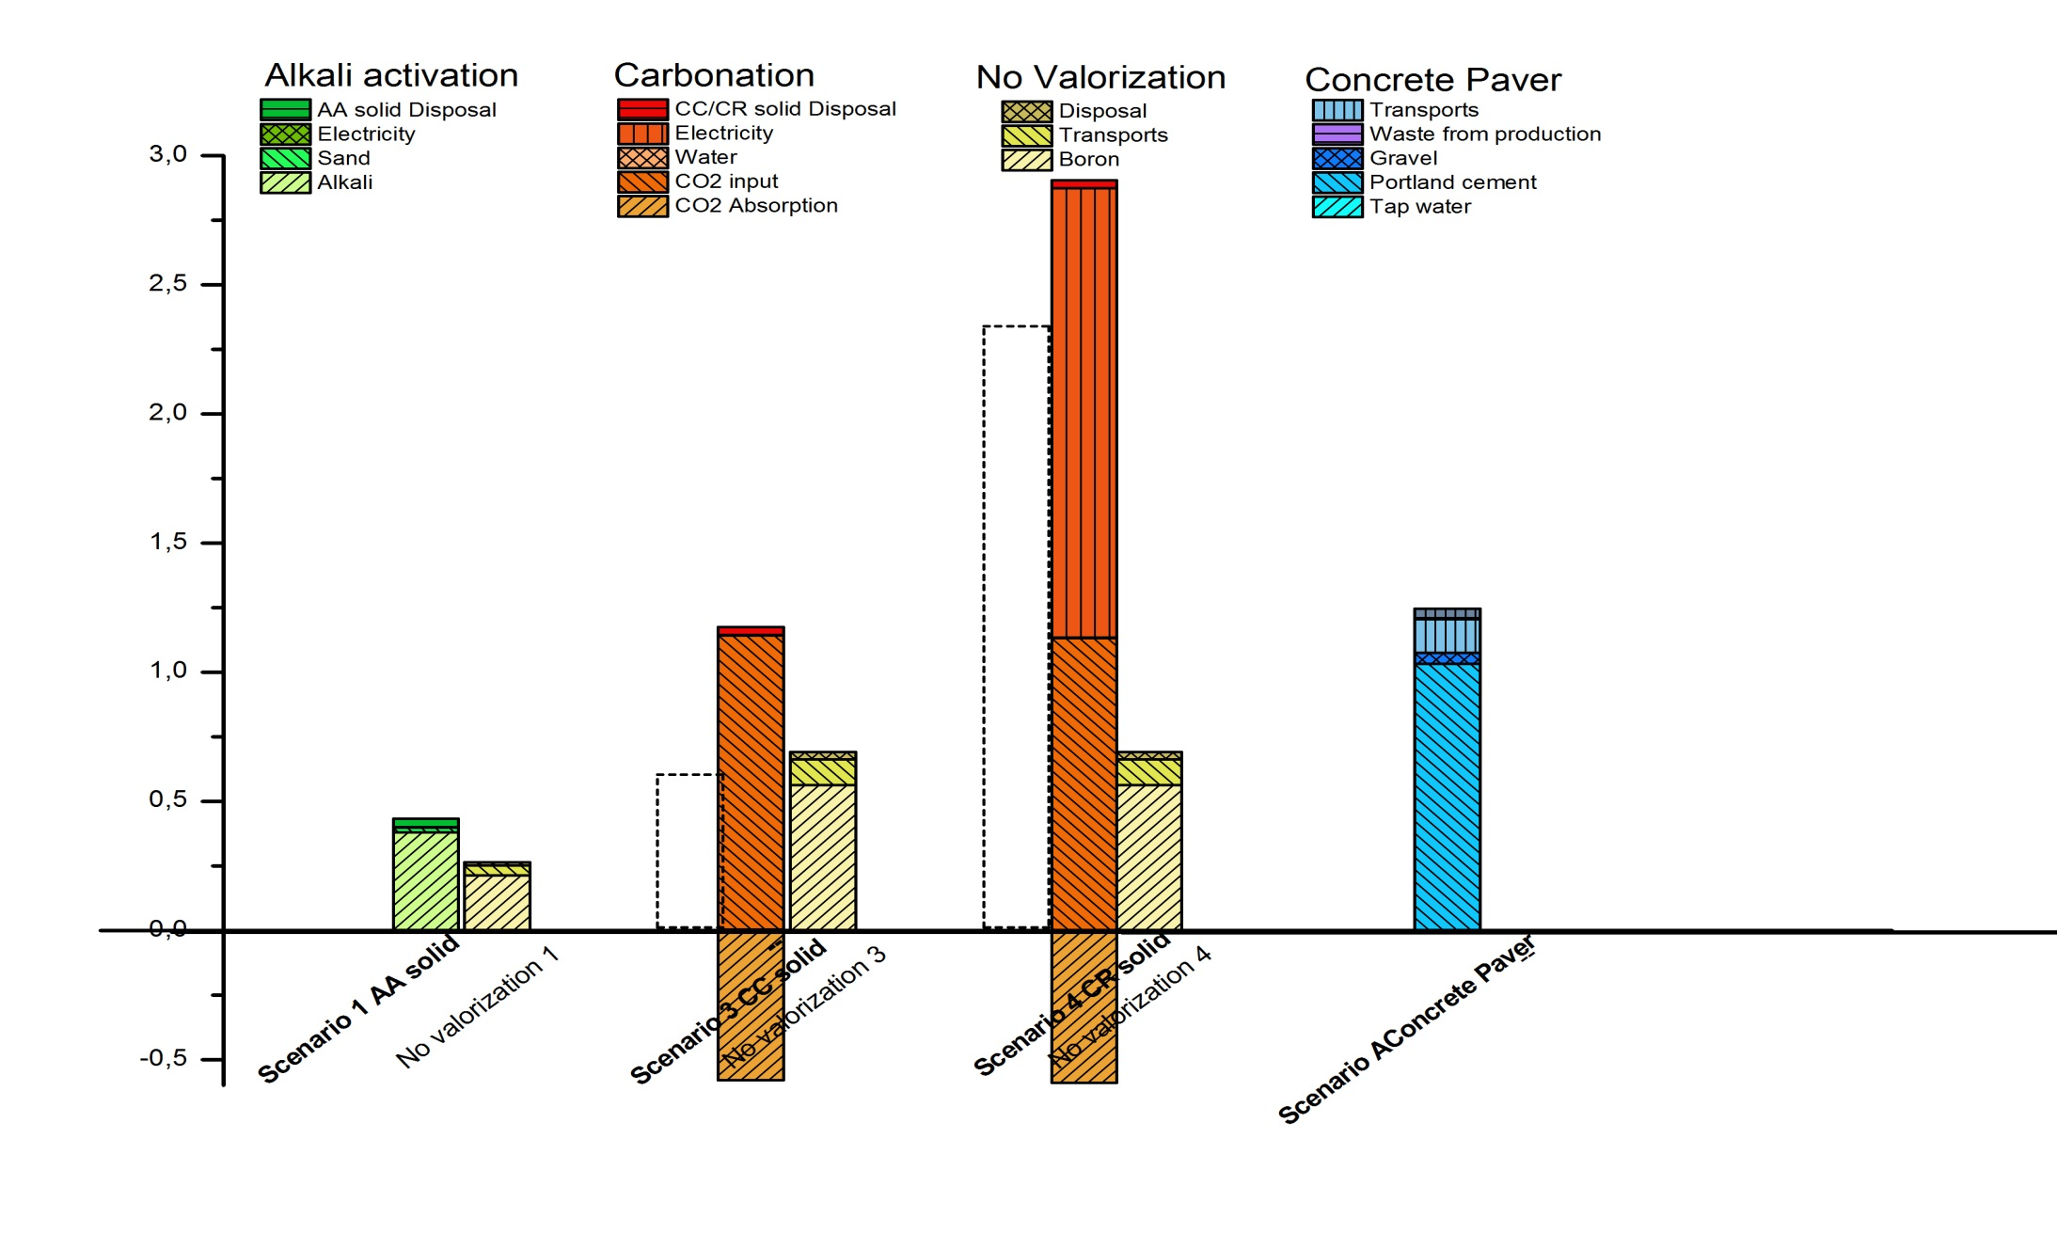
The StainlessSteelSlag (SSS) blocks: LCIA
The StainlessSteelSlag (SSS) blocks: LCA Results (1)
Comparison 1: Solid AA/CC/CR vs Concrete paver
Environmental points
22

Slide 23
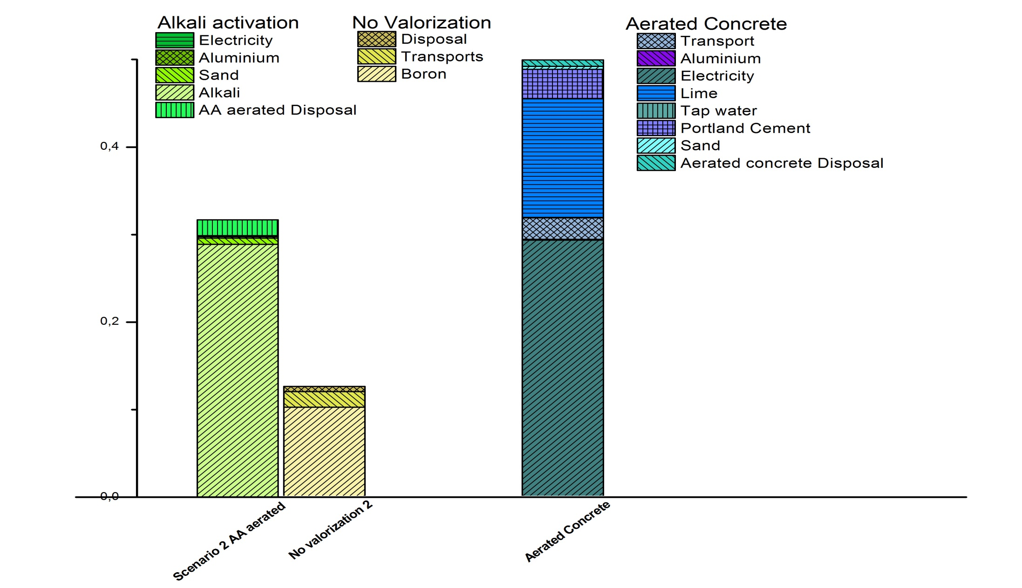
The StainlessSteelSlag (SSS) blocks: LCA Results (1)
Comparison 2: Aerated AA vs Aerated Concrete
Environmental points
23

Slide 24
The StainlessSteelSlag (SSS) blocks: Conclusions
Positive:
Saving energy
Alkali activated and carbonated (in chamber) SSS blocks lower the energy consumption (electricity or fossil fuels), which is the highest impact for conventional concrete blocks (during production of cement and binders).
Negative:
Alkali production
CO₂ stream required
Energy consumption in the reactor
In terms of industrial symbiosis
SSS valorization scenarios have higher impact that current no valorization scenario
Looking at a long term, the substitution of traditional concrete with new material from SSS reduces the total environmental impact
Industrial symbiosis presents advantages, but also limitations ( the case of carbonation in reactor)
24

Slide 25
The StainlessSteelSlag (SSS) blocks: Conclusions
Multidisciplinary paper
Construction materials from stainless steel slags: Technical aspects, environmental benefits and economic opportunities; Journal of industrial ecology; 2015
Muhammad Salman, Maarten Dubois, Andrea Di Maria, Karel Van Acker, Koen van Balen
Technical aspect
Is it possible to make bricks from slags which fulfil the current normative requirements in terms of shear stress and bearing capacity?
Environmental Aspect
Looking at the whole life cycle, what are the environmental benefits of using these new bricks compared to traditional bricks?
Economic aspect
What is the economic potential for such technologies and their strong and weak points in a view of a possible market introduction?
Innovation
- Multidisciplinary approach; - Industrial ecology concept application; -
25

Slide 26
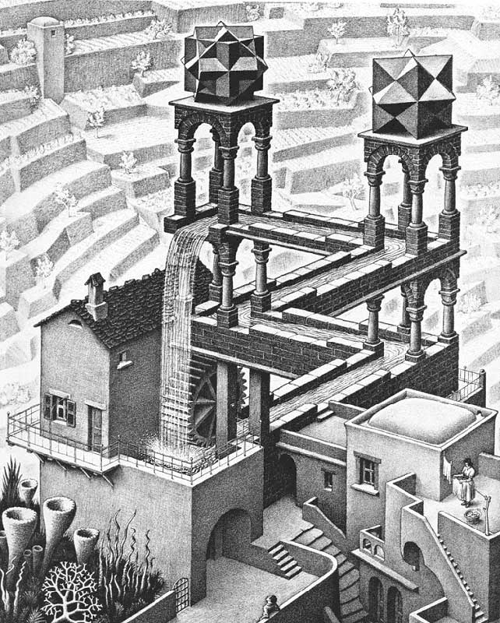
Thank you
for
your attention!
andrea.dimaria@kuleuven.be

