Slide 1
Closing remarks 4th International Slag Valorisation Symposium
Dr. Ir. Annelies Malfliet and Dr. Ir. Yiannis Pontikes

Slide 2
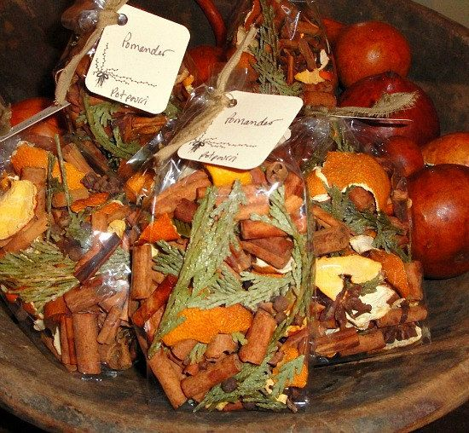
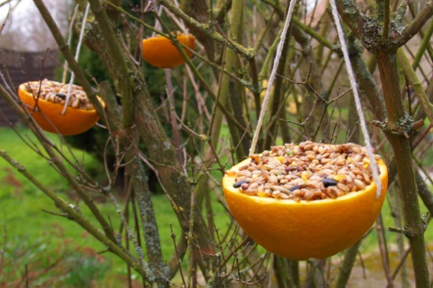
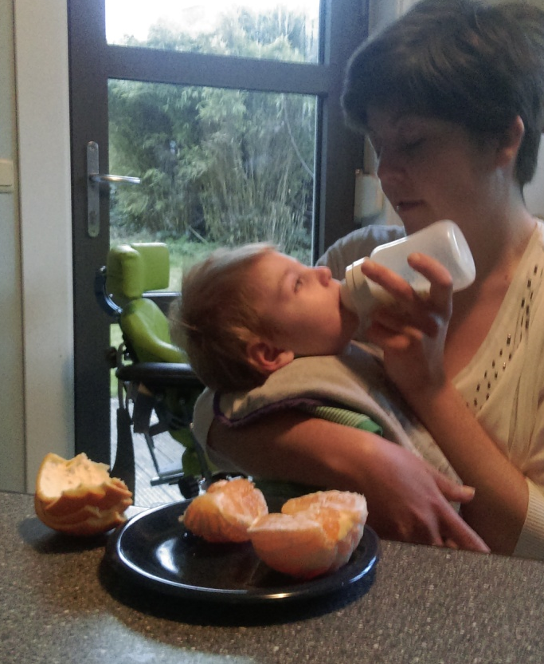
Key quotes/messages
“We have been throwing away the orange peel for decades” Mathias Chintinne (Metallo)
We need to search for
Closing the material loop/Zero waste
High-added value applications
Message for now, and especially for further generations

Slide 3
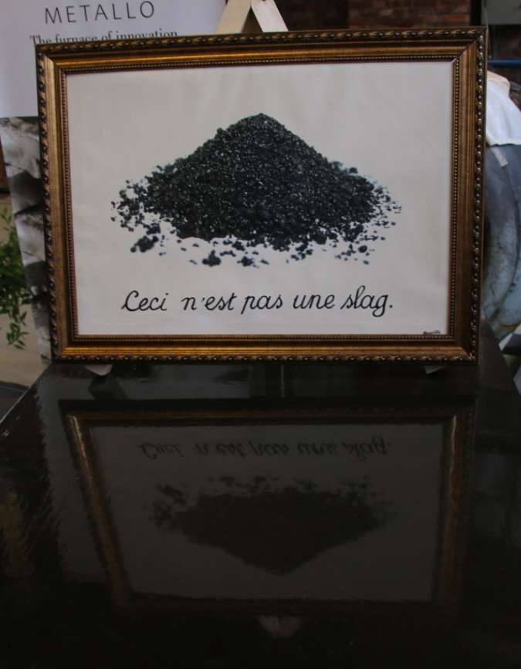
Key quotes/messages
This symposium has shown that high-temperature residues are not a waste, but can be used for high-added value purpose
Resource of energy, phosphorus, high-quality ZnO, REE, ...
Building materials, tables and benches, catalysts, glass ceramics, ...
where is the limit?

Slide 4
Key quotes/messages
Geopolymer and alkali activated materials is a reality, lets not be in denial
Leaching is important and should be addressed; try also to keep your kids from licking the walls
May one day soon the Netherlands win the world football championship
Still, championship on the use of SCMs in cement also counts
Why does it take 20 years for the rest to follow the Dutch?

Slide 5
Key quotes/ideas
Design materials that fit the purpose and go beyond the mono-supply of OPC
Rediscover the past and read Purdon’s paper from the 40s
Compare performance by the “attest” approach
Zn and Pb fuming can take place and leads to “clean” slags
Metallo-Chimique paves the way
Publish in Journal of Sustainable Metallurgy; free to publish, free to download, worldwide audience (please send me back my single copy...)

Slide 6
Key quotes/ideas
Vitrify, sinter, glaze…options to use a number of streams of residues
Zeolites, catalysts, oxides in need for sophisticated products
Slag valorisation to the level of jewellery is the next level of slag upgrading!
Which requires new words (next to “valorisation”) to go beyond the past:

Slide 7
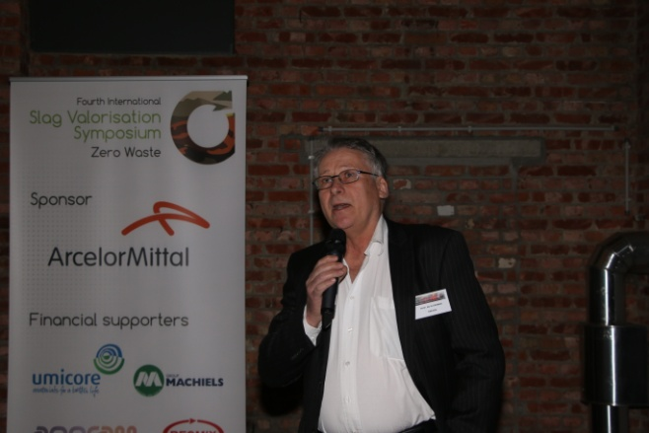
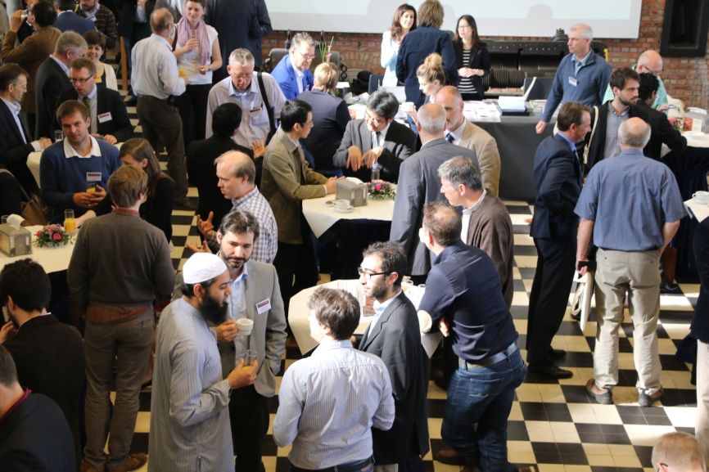
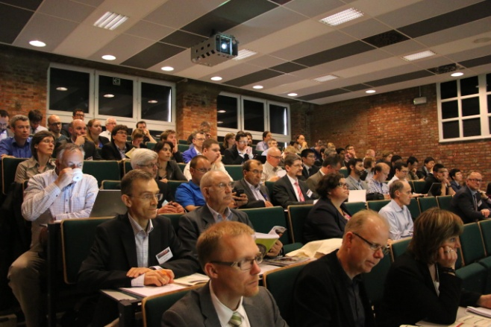
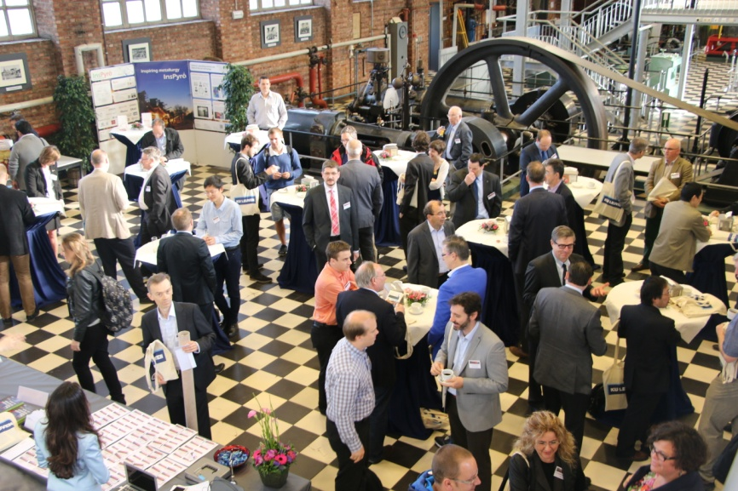
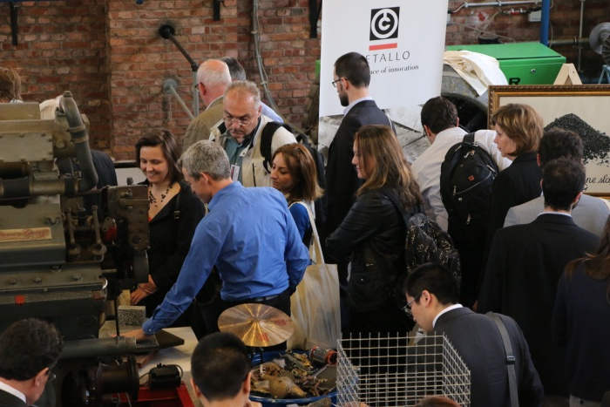
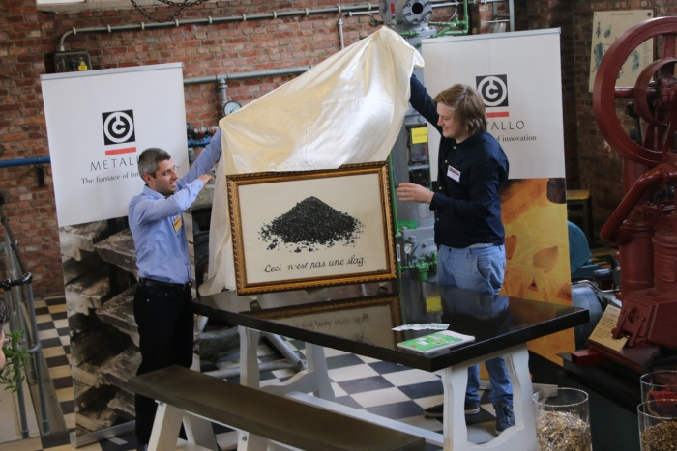
4th SVS: succesful event
Place to share knowledge, science, understanding ...
... And to see that it is happening

Slide 8
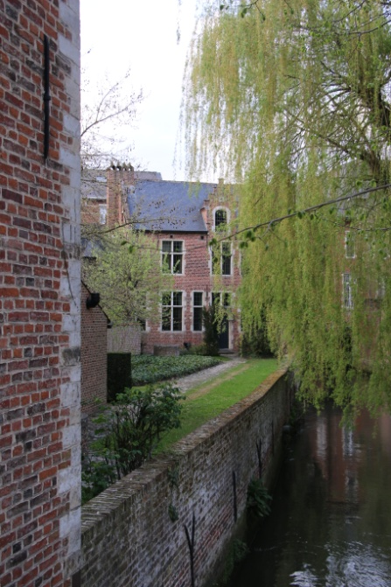
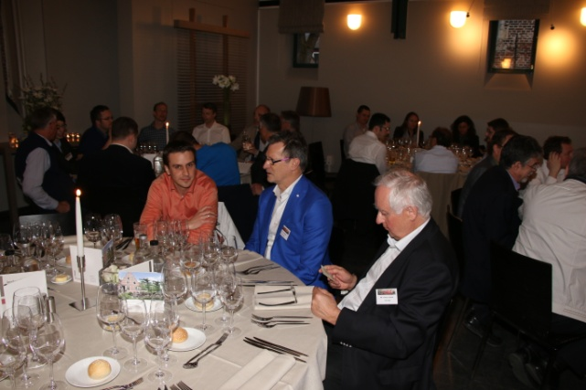
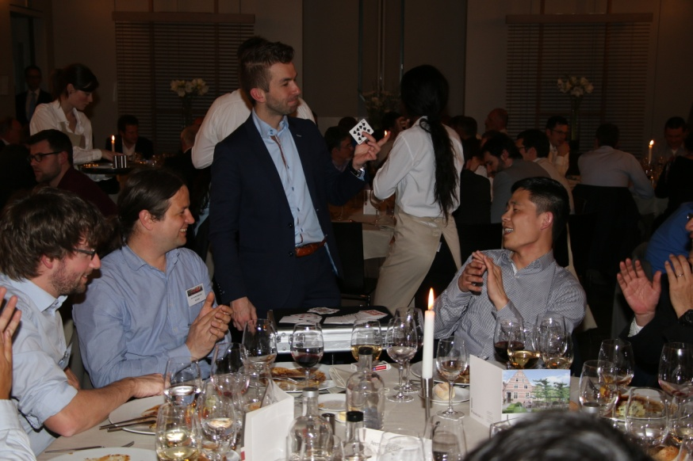
4th SVS: succesful event
With some culture....
... Food, wine, entertainment, ...
... And some magic!!

Slide 9
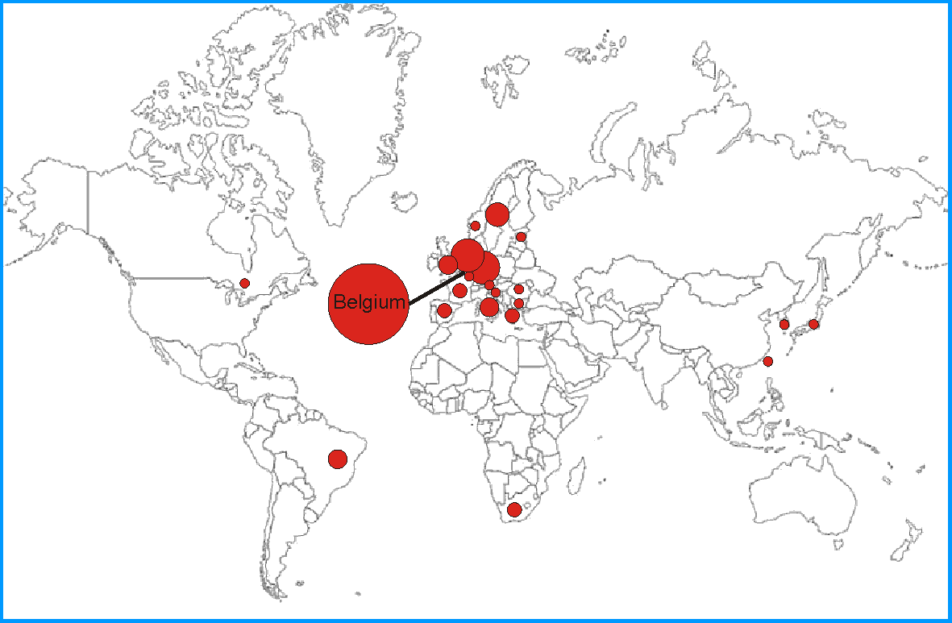
Thanks to ...
All participants
All speakers
All chairpersons
All members of the Scientific Committee
All sponsors, supporters and exhibitor
Technical, administrative, IT and logistics support by Department of MTM
The organising team, especially all members of HiTemp Group
Special word of thanks to conference coordinator Rabab Nasser

Slide 10
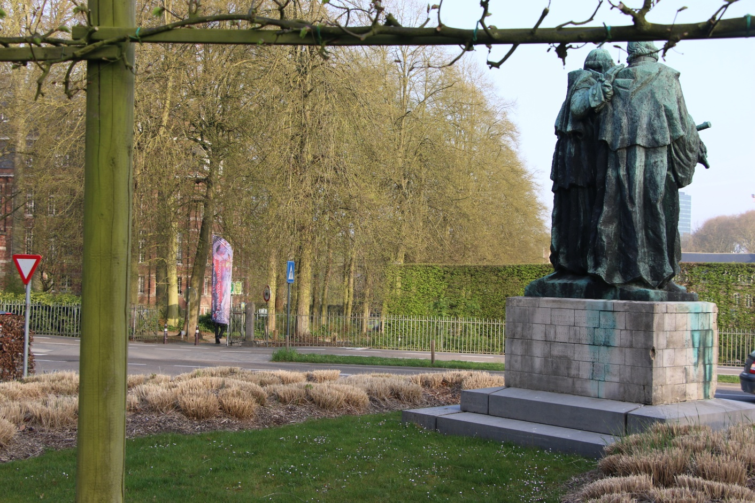
The end
A nice trip back ... and see you next time!

