Slide 1
Synthesis and characterisation of porous inorganic polymers from fayalite slag
L. Kriskova, P. T. Jones, H. Janssen, B. Blanpain, Y. Pontikes

Slide 2
Starting materials
Fayalite slag
Activating solution - Na₂O. SiO₂
Na₂O / SiO₂ = 0.85
H₂O / Na₂O = 22.2
Al powder
0.05 – 0.15 wt.% slag
 | FeO | SiO₂ | ZnO | Al₂O₃ | CaO | PbO | MgO | Na₂O | Cr₂O₃ | others
wt.% | 57.4 | 26.4 | 6.2 | 3.4 | 2.3 | 0.7 | 0.7 | 1.0 | 0.7 | 1.2

Slide 3
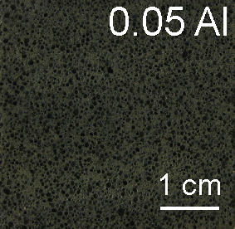
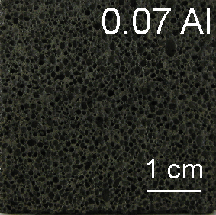
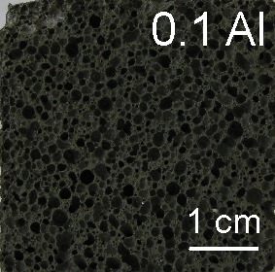
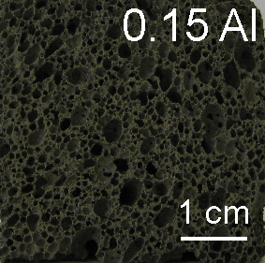
Macro & Micro- structure
0.05 Al
0.15 Al

Slide 4
Properties

Slide 5
Thank you!

